Slide 1
Assessing Outcomes in a New Era of Achondroplasia Treatment
Minutes
Tuesday 9th April 2024

Slide 2
Meeting summary

Slide 3
Presentation Summary
Therapeutic Management of Achondroplasia in the Real World
Achondroplasia requires lifelong care
Treatment can have a big impact beyond an increase in height
Are Current Outcome Measures in Achondroplasia Still Fit for Purpose?
Review of anthropometric, QoL, independence and functionality outcome measures
Collecting real-world data is important to understanding the condition and the impact of any treatment
Exploring the Future of Achondroplasia Treatment
Review of the benefits of treatment, available options and potential combinations

Slide 4
Meeting Minutes
Resources are needed to consistently and accurately capture all aspects of achondroplasia care
QoL measures are often the most difficult to capture consistently due to
Numerous tools used within and between centres
Time constraints in the clinic
A streamlined, achondroplasia specific QoL measure would be beneficial
Multi-sponsor support to develop new outcome tools would help
Access to registries is needed to ensure data is captured and can be shared to increase understanding of the condition and the impact of treatment

Slide 5
Attendee Overview
 | Assessing Outcomes in a New Era of Achondroplasia Treatment April 2024 | Understanding Sleep Studies in Achondroplasia: Which? When? Why? October 2023 | Clinical Management Challenges in Infants and Young Children October 2022 | Detection and Management of Foramen Magnum Stenosis April 2022 | Managing Achondroplasia into Adulthood October 2021
Number of attendees (total) HCP PAG | 63 38 3 | 55 40 2 | 59 45 6 | 61 47 5 | 45 26 7
Other* | 5 | 0 | 0 | 0 | 0
Number of sponsors attending | 17 | 13 | 8 | 9 | 12
Number of countries represented | 24 | 17 | 15 | 17 | 16
*Other attendees included students, medical writers and pharmaceutical company members not sponsoring the EAF

Slide 6
Objectives
Review whether current outcome measures for achondroplasia are still fit for purpose in the era of therapeutic management
Explore real-world experience of available therapeutic options from both a patient and healthcare professional perspective
Review therapeutic options in the pipeline and discuss potential future treatment paradigms

Slide 7
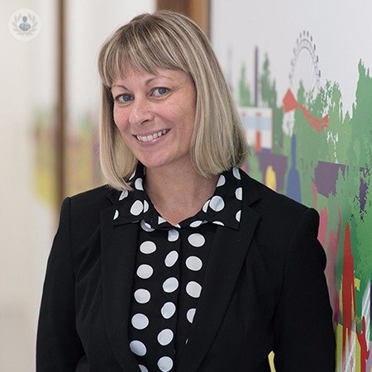
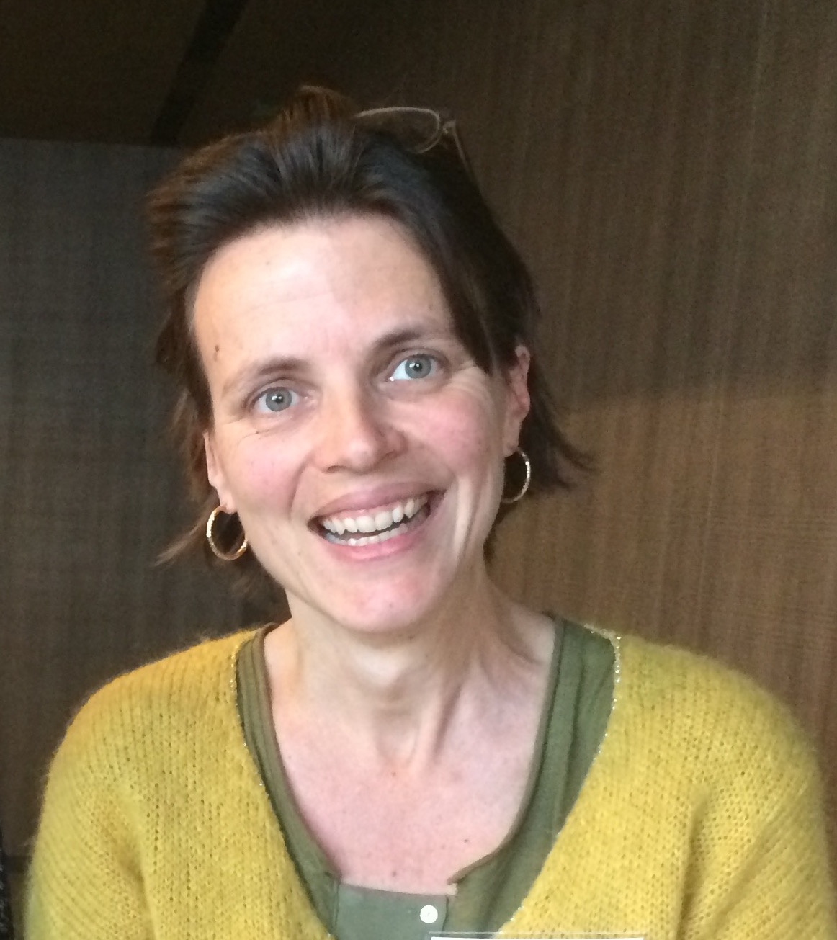
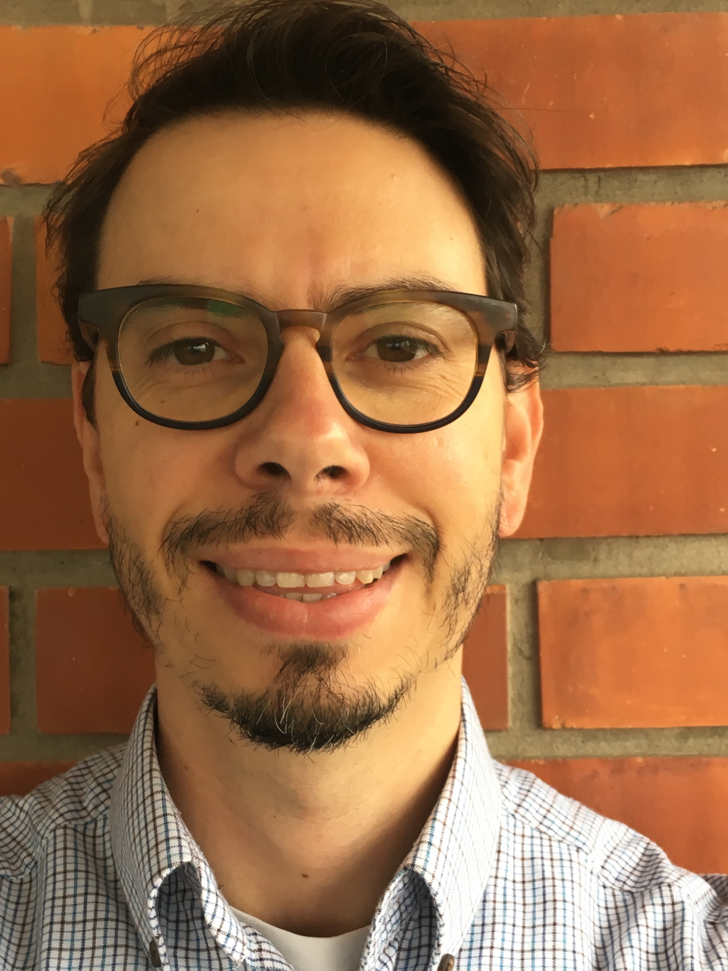
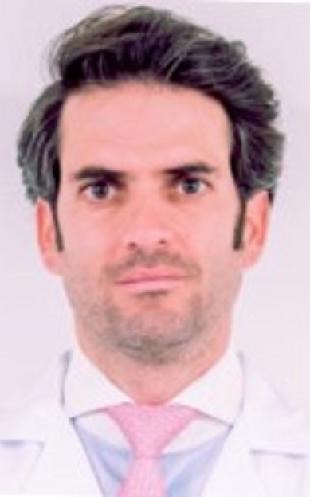
Agenda
Assessing Outcomes in a New Era of Achondroplasia Treatment
Therapeutic Management of Achondroplasia in the Real World | Geneviève Baujat
Are Current Outcome Measures in Achondroplasia Still Fit for Purpose? | Sérgio de Sousa and Antonio Leiva-Gea
Exploring the Future of Achondroplasia Treatment | Melita Irving and Antonio Leiva-Gea
Summary and Close | Melita Irving

Slide 8
Evaluations

Slide 9
All Respondents Found the Event to be of a Very High Standard
Based on data from 20 respondents

Slide 10
90% of Respondents Felt the Content met Educational Goals
Based on data from 20 respondents

Slide 11
Feedback from Attendees
My personal living experiences were beginning to be represented clearly, through clinical ethos and sincerity.
I am not a Medical Doctor. Accessing up-to-date, relevant information is not always available to me. Being invited to these workshops, is lifesaving.
This was great. I am in the US, but we have a lot of the same struggles. We certainly do less limb lengthening so it was interesting to hear that talked about so much.
There is a need for EAF 'Ambassadors', not just 'pharmaceutical reps’. People with living experience need to raise EAF awareness, go beyond the patient/doctor interactions, it takes a village.
Great talks! Very important issues to discuss as new treatment options emerge
Based on data from 3 responses

Slide 12
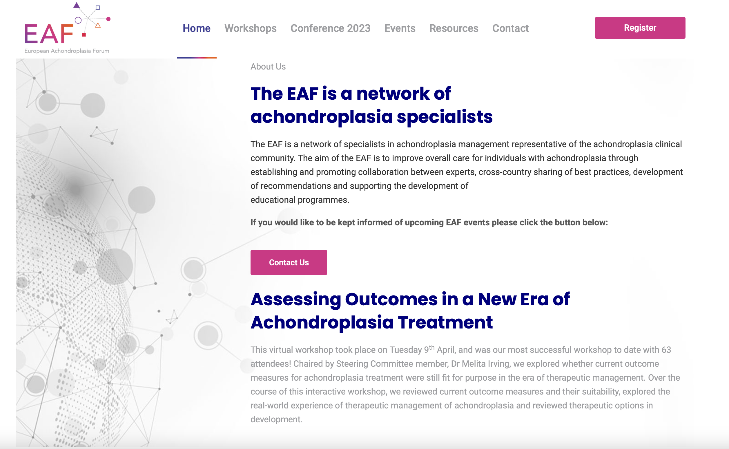
Summary
Outcome measures need to be re-evaluated to streamline and standardise data collection
Keep an eye out for our manuscript capturing the outcomes of the workshop!
Make sure you follow us on X (formerly Twitter)
@ACHONforum
Register at the EAF website to be notified about our next workshop achondroplasiaforum.com/register

