Slide 1
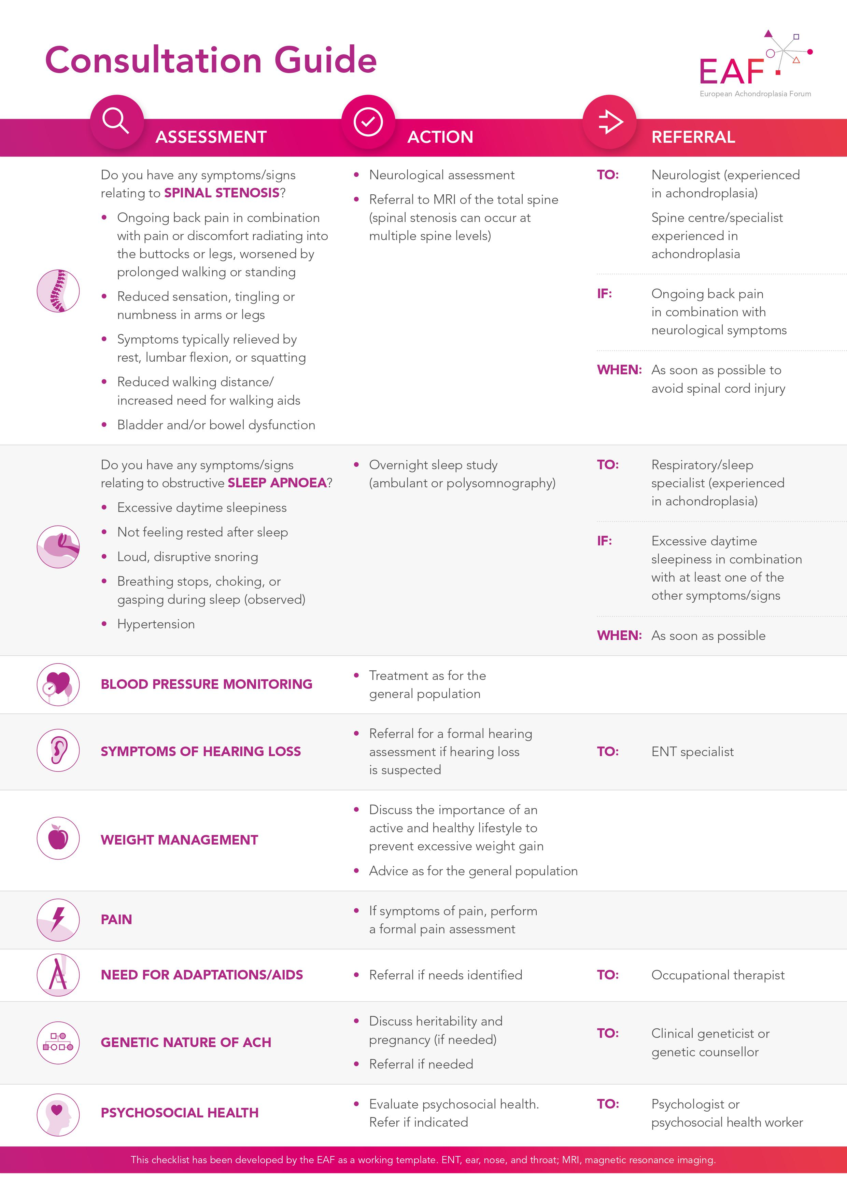
European Achondroplasia Forum: Practical Considerations for Following Adults with Achondroplasia – A Patient-held Checklist Svein Fredwall,¹ Moeenaldeen AlSayed,² Tawfeg Ben-Omran,³ Silvio Boero,⁴ Valérie Cormier-Daire,⁵ Brigitte Fauroux,⁶ Encarna Guillen-Navarro,⁷ Florian Innig,⁸ Philip Kunkel,⁹ Christian Lampe,¹⁰ Mohamad Maghnie,¹¹ Klaus Mohnike,¹² Geert Mortier,¹³ Zagorka Pejin,⁶ Marco Sessa,¹⁴ Sérgio de Sousa,¹⁵ Melita Irving¹⁶
C-0023
1. Sunnaas Rehabilitation Hospital, TRS National Resource Centre for Rare Disorders, Nesodden, Norway; 2. Department of Medical Genomics, King Faisal Specialist Hospital and Research Centre; and Faculty of Medicine, Alfaisal University, Riyadh, Kingdom of Saudi Arabia; 3. Division of Genetics and Genomic Medicine, Sidra Medicine & Hamad Medical Corporation, Doha, Qatar; 4. IRCCS Istituto Giannina Gaslini, Genoa, Italy; 5. Paris Descartes University, Paris, France; 6. Hôpital Necker-Enfants Malades and Univesité Paris Cité, France; 7. Medical Genetics Division and Pediatrics Department, Virgen de la Arrixaca University Hospital, IMIB-Pascual Parrilla, University of Murcia; and CIBERER-ISCIII, Madrid, Spain; 8. BKMF e.V., Bremen, Germany; 9. University Medical Centre Mannheim, Germany; 10. Clinic of Child and Youth Medicine, University Hospital Mannheim, Germany; 11. Paediatric Endocrinology Unit, IRCCS Istituto Giannina Gaslini; and Department of Neuroscience, Rehabilitation, Ophthalmology, Genetics, Maternal and Child Health, University of Genoa, Italy; 12. Children’s Hospital, Otto-von-Guericke-University Magdeburg, Germany; 13. Centre for Human Genetics, University Hospitals Leuven, Belgium; 14. Association for Achondroplasia Information and Study, Milan, Italy; 15. Medical Genetics Department and Clinical Academic Center of Coimbra, Hospital Pediátrico de Coimbra; and University Clinic of Genetics, Faculty of Medicine, University of Coimbra, Portugal; 16. Guy’s and St Thomas’ NHS Foundation Trust, London, UK
Background
The EAF Patient-held Checklist
Achondroplasia requires lifelong access to a multidisciplinary team
Many people are lost to follow up after the transition from paediatric to adult care; often people feel healthy at this time and may not feel there is a need for accessing regular medical care
There is no standardised approach to the management of achondroplasia in adults; routine check-ups are not necessarily needed if adults are feeling well
A Patient-held Checklist
The European Achondroplasia Forum (EAF) has developed a patient-held checklist to support adults with achondroplasia manage their health by
Supporting ongoing systematic and structured monitoring
Guiding consultations and discussions
Empowering people to manage their own health
The checklist
Highlights key symptoms of spinal stenosis and obstructive sleep apnoea
Acts as a framework to support individuals and their primary care provider in completing routine review
Key Complications in Adults with Achondroplasia: Symptomatic Spinal Stenosis
Potentially severe complication; may cause neurological symptoms, pain, and impact on physical functioning and activities of daily living
First symptom onset varies, but majority of people develop symptoms in their mid-30s and early 40s
Key symptoms to be aware of:
Back pain, radiating into buttocks or legs
Decreased walking distance
Symptoms relieved by squatting or rest
Bladder and bowel symptoms, including urinary urgency
Scan to access the EAF’s website, and download the consultation guide
Key Complications in Adults with Achondroplasia: Obstructive Sleep Apnoea
Implementation in Clinical Practice
Highly prevalent; may have severe consequences if untreated, including hypertension, cardiovascular disease, stroke
Key symptoms to be aware of:
Excessive daytime sleepiness, in combination with
Loud snoring
Breaks in nocturnal breathing
Hypertension
The EAF propose the consultation guide is part of the transition from paediatric to adult care
Implementation should be on an opt-in basis; patient choice is very important
Communication of the benefits of proactive management of any symptoms that may arise is important, so individuals are confident working with their primary care provider for ongoing health/wellbeing
Conclusions
The EAF advocates the development of a patient-held checklist to support adult follow up
The checklist aims to empower adults with achondroplasia and their primary care provider to understand their condition, recognise key symptoms, direct resources and ensure timely referrals to specialists
Ongoing multidisciplinary care is necessary, for adults to access as they require. Having centres of expertise in achondroplasia in each country/region can support effective ongoing care, particularly for spinal stenosis and obstructive sleep apnoea in adulthood
Conflicts of Interest
SF, MAS, TBO, BF, CL: nothing to disclose. SB: payment or honoraria, support for attending meetings and/or travel from BioMarin. VCD: received payment or honoraria, support for attending meetings and/or travel from BioMarin. SS: payment or honoraria, support for attending meetings and/or travel and has participated in Advisory Boards for BioMarin. EGN: payment or honoraria, support for attending meetings and/or travel from BioMarin. FI: grants or contracts paid to BKMF e.V from BioMarin. MI: grants or contracts and consulting fees from BioMarin, QED/Bridge Bio, Ascendis, Sanofi, Tyra, NovoNordisk; payment or honoraria from BioMarin; Advisory Boards for BioMarin and QED/Bridge Bio. PK: payment or honoraria, support for attending meetings and/ or travel from BioMarin. MM: consulting fees, payment or honoraria, support for attending meetings and/or travel and Advisory Boards for BioMarin. KM: consulting fees from BioMarin and NovoNordisk, payment or honoraria from Kyowa-Kirin, support for attending meetings and/or travel from BioMarin, Advisory Boards for QED and is Vice-Chair of BKMF. GM: payment or honoraria and support for attending meetings and/or travel from BioMarin, Advisory Boards for Sanofi. ZP: consulting fees and payment or honoraria from Orthofix Italy and Newclip France; support for attending meetings and/or travel from Orthofix Italy, and patents planned, issued or pending with Orthofix Italy. MS: grants or contracts paid to AISAC OdV from BioMarin and QED
Presented at 16th International Skeletal Dysplasia Society Meeting, 18–21st September 2024, Madrid, Spain

